Slide 1
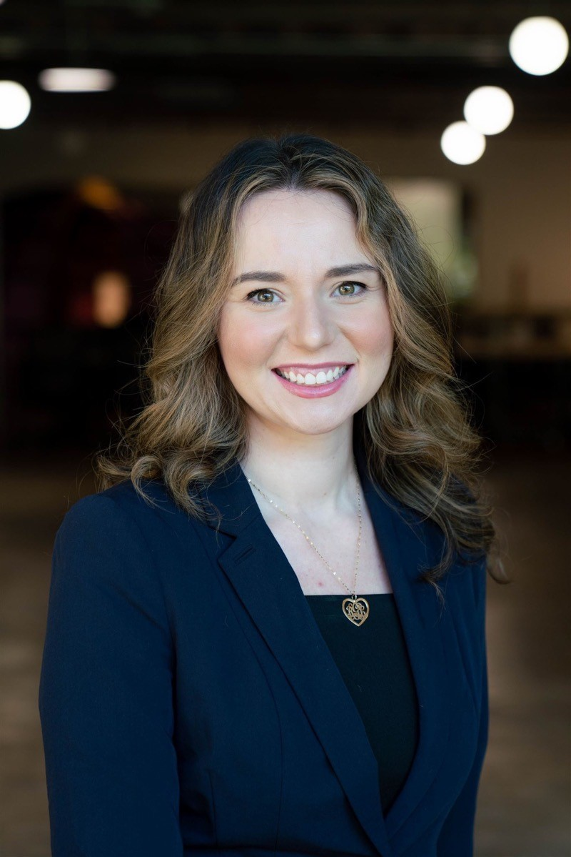
Bora Laci Senior Consultant Acceleration
Location
Dallas, Texas
Email
Bora.laci@thebridge.com
Mobile
214.934.2537
EXPERIENCE
Industry Experience
Healthcare, Utilities, Manufacturing, Media, Distribution/Retail, Non-profits, Education
With over a decade of experience, Bora partners with clients across industries to implement high-impact strategies that drive growth and transformation. From guiding established businesses to optimizing emerging startups, Bora has led comprehensive strategy-to-execution projects in management consulting, community engagement, and marketing environments. Her ability to blend business acumen with a passion for aligning social missions with organizational objectives has delivered measurable results across diverse sectors.
Bora’s approach focuses on strategic planning, operational efficiency, and financial analysis, always challenging clients to envision long-term success while making data-driven decisions that ensure immediate value. She excels at building and guiding cross-functional teams, ensuring that every initiative not only meets performance targets but also fosters collaboration and growth.
Management Consulting| Dallas, TX
Directed large-scale, cross-industry projects to enhance operational efficiency and develop strategic training programs, contributing to over $1.5 million in annual savings
Collaborated with executive leadership to align strategic initiatives, ensuring seamless execution and improved revenue forecasts
Non-Profit & Public Affairs | Dallas, TX
Led community outreach initiatives that increased member engagement by 35% and annual revenue by 75%. She also enhanced the organization’s visibility by executing a comprehensive public relations and marketing plan, boosting media coverage and social media engagement
Public Policy & Fundraising Strategy | Dallas, TX
Managed a $2 million fundraising campaign, increasing web donations by 58% and securing $500,000 in new donor commitments
Introduced CRM tools, boosting client growth by 45% and improving email engagement by 65%, while achieving significant cost savings
Marketing & Advertising Strategy | Dallas, TX
Optimized advertising strategies for high-value clients, increasing B2B retention by 60% and improving overall campaign performance
Managed a portfolio of clients with accounts totaling $6.5 million, delivering superior results through data-driven insights and performance reviews
SKILLS
AWARDS & CERTIFICATIONS
Strategic Planning & Implementation, Cross-Organization Integration, Problem Solving & Analytical Thinking, Leadership & Relationship Building, Financial Analysis, Communication Strategy
20 under 40 Park Cities
SMU Alumni Board Member
Executive Organizer, Dallas Meet Up
Dallas Entrepreneurial Center Board Member & Mentor
AT&T Performing Arts Advisory Board member

